Slide 1

Instructor Kick-off
Analyze A/B Test Results
© 2019 Udacity. All rights reserved.

Slide 2
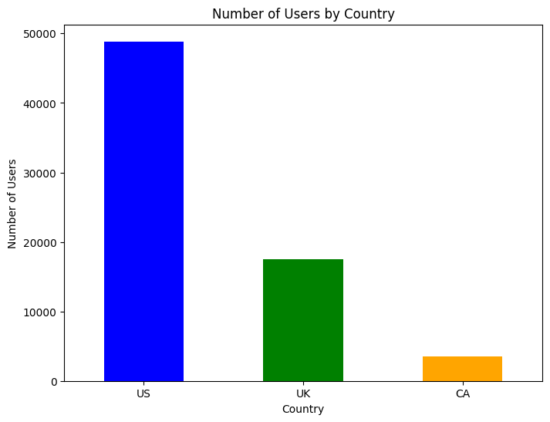
How Was The Experiment Implemented?​
Total Variant Visitors: 69889
Total Control Participants:​ 34678

Slide 3
Conversion Rates
 | U.S. | U.K. | CA
Control | 10.7% | 10.16% | 9.4%
Treatment | 15.8% | 14.86% | 15.4%
Executive Summary:
1.The data suggests that the Treatment is associated with higher conversion rates in all three countries.
2.Country also plays a role in the conversion rates, with the U.S. having the highest overall conversion rates, followed by Canada and the U.K..

Slide 4
Experiment Results
Treatment Conversion Rate: 15.5%
Control Conversion Rate:10.5​%
Delta in Treatment vs. Control Conversion Rate:5%​
p-value:​0.0
The Treatment group has a 5% higher conversion rate than the Control group. With a p-value of 0.0, the difference is statistically significant, meaning the Treatment likely has a positive impact on conversions.

Slide 5
Country Results
There is a difference but not statistically difference , since the p_values are .905 , .17 for each of UK and US respectively

